Slide 1


Operational Excellence Maturity Measurement Report
Cyber Security Sector
Governance, Risk & Compliance GD
7th Jul 2020

Slide 2
Document Control
Version Control
Version | Date | Author(s) | Changes | Reviewed By
0.1 | 7th July 2020 | Devoteam | First Version | STC Track Leader
The document owned by
Version | Name | Position
1.0

Slide 3
Table of Content
Title | Page Number
1.0 Introduction | 4
2.0 Operational Excellence Maturity Measurement Result | 8
3.0 Maturity Assessment Framework Criteria and Formula | 14

Slide 4


1.0 Introduction

Slide 5
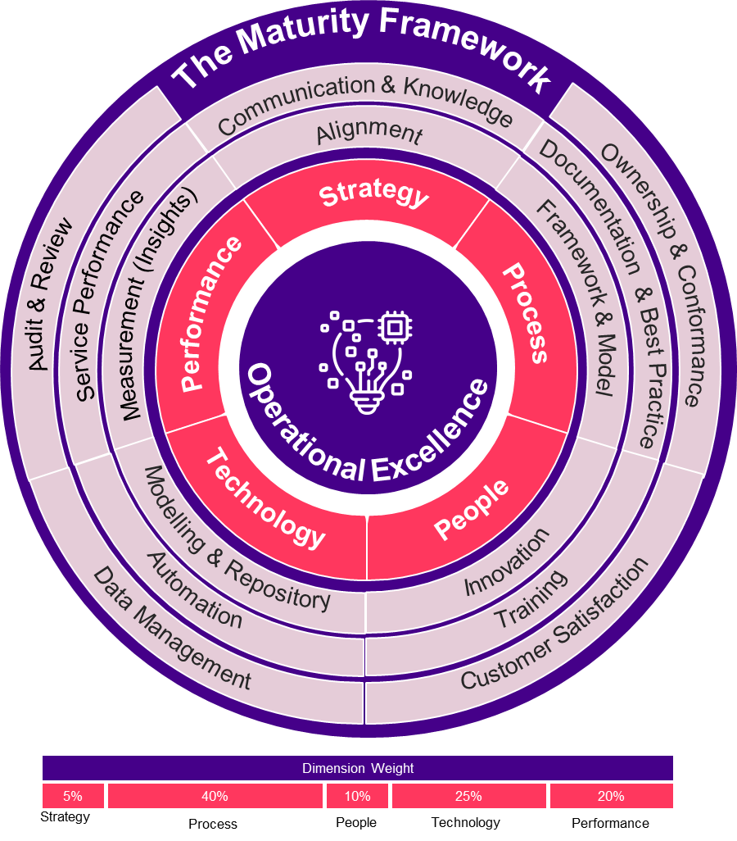
1.1 Operational Excellance Maturity Model Overview
The operational excellence enhanced model
The Operational Excellence Maturity Model (OXMM) is a tool to help STC – TechOps measure and assess areas (dimensions) that enable and support operational excellence within TechOps Sectors.
The operational excellence maturity model has been used during 2019 to measure the operational maturity of TechOps General Directorates (GDs) and consequently the Sectors and TechOps overall. The measurement result of 2019 is considered as a baseline for later maturity measurements comparisons and progress tracking.
Part of track one scope of the Business Process Excellence project is to review the current maturity model and accordingly improve it and enhance it.
In enhancing the maturity model, the baseline structure of the model (dimensions / criteria) was preserved while introducing additional improvements in terms of domains / criteria. Improving the model while preserving the baseline structure will allow to conduct measurements as part of the scope of the project and to have like-for-like comparisons with the baseline measurement of 2019 while at the sometime providing an improved framework for future measurements.
The proposed Operational Excellence Maturity Model
Consists of :
5 dimensions
Each dimension consists of several sub-dimensions (the total is 14).
Each sub-dimension is measured through several criteria. A total of 30 criteria have been defined.
The dimensions have different weights reflecting its importance.
The model dimensions and sub-dimensions and the weight of each dimension is shown in Figure 1.
0 – 20% | Fragmented
21 – 40% | Basic
41 – 70% | Established
71 – 90% | Mature
91 – 100% | Excellent
Figure 1
There are Five (5) Levels of Maturity Identified per Dimension and for the whole Model (Initial - Basic - Established - Mature - Excellent

Slide 6






1.2 OX Measurement Objectives
The OX maturity model reflects several domains of operation excellence that will support TechOps to measure and track progress towards realizing the following:
Continuous Strategic Alignment
Innovative & Customer Centric Culture
Operational Insight
Adaptive processes
Smart Automation

Slide 7
1.3 GD Assessment and Data Gathering
The OXM measurement journey passed through the following steps:
OXM Measurement Kick-off: Kick-off Orientation sessions to Sectors on OXM Model Dimensions, sub-dimensions, Criteria, Weights, Formulas and required Evidences
Sector per Sector Targeted SMEs Orientation Sessions: OXM model detailed orientation sessions with GDs SMEs further explaining the OXM Model Dimensions, sub-dimensions, Criteria, Weights, Formulas and required Evidences.
GDs SMEs Targeted One – to-One Meetings: then one-to-one meetings with SMEs were conducted to clarify any ambiguity about the model and to clarify the necessary evidence for criteria measurement as well as answer specific questions SMEs had on the model and its criteria..
GDs Evidence Collection and Validation Meetings: A number of meetings were conducted to collect the required evidence, validate communicated evidence and highlight missing evidence in order to ensure all required information as applicable is collected from the relevant GD.
GDs Score review and finalization meetings: Finally, a score review meeting was conducted with each GD to share the initial result with the GD SMEs in order to explain the result, get any feedback and to fulfill any evidence gaps or missing information which not was shared before. The score of the GD is then finalized.
The table below shows the OXM assessment phases along with the progress timeline :
June 2020
14 | 15 | 16 | 17 | 18 | 19 | 20 | 21 | 22 | 23 | 24 | 25 | 26 | 27 | 28 | 29 | 30 | 01 | 02 | 03 | 04 | 05 | 06 | 07 | 08 | 09 | 10 | 11 | 12 | 13 | 14 | 15 | 16
One-to-One GDs SMEs (OX Framework)
Conduct Ops. Excellence Measurement
Report on Measurement Outcomes
SME One to One Evidence Requirements Review
Progress Review with SME
Progress Review with SME
Score Review and Validation with SME
Score Review and Validation with SME
Present Outcomes to Stakeholders
Finalize Measurement Outcomes Report
Distribute Measurement Outcomes Report

Slide 8
2.0 Operational Excellence Maturity Measurement Result

Slide 9
2.1 Operational Excellence Maturity Model Criteria
The following diagram present the maturity model criteria and status of criteria measurements. Four criteria have not been measured (criteria: 2.1.1, 2.3.2, 3.3.2, 4.1.1) during this exercise because fulfilling the criteria requires the preparation of specific capabilities (example: process mining scripts). These four (4) criteria will be measured in the future once the missing repreparation
1.0
Strategy
2.0
Process
3.0
People
4.0
Technology
5.0
Performance
1.1
Alignment
1.2 Communication & Knowledge
2.1
Framework & Model
2.2
Documentation & Best Practice
2.3
Ownership & Conformance
3.1
Innovation
3.2
Training
3.3
Customer Satisfaction
4.1
Modelling & Repository
4.2
Automation
4.3
Data Management
5.1
Measurement (Insights)
5.2
Service Performance
5.3
Audit & Review
1.1.1
1.2.1
2.1.1
2.2.1
2.3.1
3.1.1
3.2.1
3.3.1
4.1.1
4.2.1
4.3.1
5.1.1
5.2.1
5.3.1
2.1.2
2.2.2
2.3.2
3.2.2
3.3.2
4.2.2
5.1.2
5.2.2
2.2.3
4.2.3
5.1.3
2.2.4
4.2.4
2.2.5
2.2.6
Color Legend
2.2.7
Measured Criteria
Not Measured/Applicable Criteria

Slide 10
2.2 Overall OX maturity Result
TechOps Measurement for last year (2019), the current measurement and the target at the end of this year (2020)
Cyber Security GRC Measurement for last year (2019), the current measurement and the target at the end of this year (2020)
100
90
80
70
60
50
40
30
20
10
100
90
80
70
60
50
40
30
20
10
75 %
70 %
The Target
The Target
The current Measurement
X%
Maturity
42%
Maturity
The baseline
30%
32.2%
The baseline
The current Measurement
Jun 2019
Jun 2020
Dec 2020
Jun 2019
Jun 2020
Dec 2020
Time
Time
TechOps
Cyber Security - GRC

Slide 11
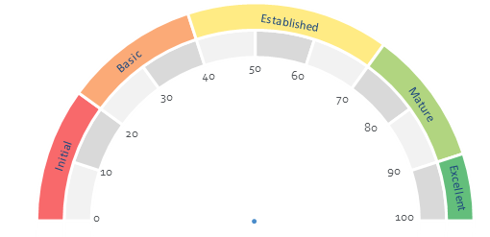
2.3 Detailed Operational Excellence Maturity Result
2019 OX Measurement
2020 OX Measurement
30%
32.2%
No | Dimension | Weight | Score | Rank
1 | Process | 40% | 30% | 12.0%
2 | Quality Culture | 10% | 30% | 3.0%
3 | Automation | 20% | 30% | 6.0%
4 | Measurement | 30% | 30% | 9.0%
No | Dimension | Weight | Score | Rank
1 | Process | 40% | 30.4% | 12.2%
2 | Quality Culture | 10% | 23.9% | 2.4%
3 | Automation | 20% | 33.0% | 6.6%
4 | Measurement | 30% | 36.7% | 11.0%
The radar chart compare the result between the last year and this year using the 4 OXM dimensions
The cyber security sector has not been measured last year and has been provided a fundamental baseline score of 30%

Slide 12
2.4 Enhanced Operational Excellence Maturity Result
Here is the result using the new enhanced OXM model
No | Dimension | Weight | Score | Rank
1 | Strategy | 5% | 100.0% | 5.0%
2 | Process | 40% | 40% | 16.2%
3 | People | 10% | 12% | 1.2%
4 | Technology | 25% | 23% | 5.7%
5 | Performance | 20% | 42% | 8.4%
36.5%

Slide 13
2.5 Criteria Detailed Scores
Not Measure/Applicable
Criteria Result Percentage
1.0
Strategy
2.0
Process
3.0
People
4.0
Technology
5.0
Performance
100%
40%
12%
23%
42%
Dimension Average
Note: The above are the per criteria scores as calculated through criteria formulas. The above do not include the criteria weight or dimension weight (which were presented in previous slides)

Slide 14
3.0 Maturity Assessment Framework
Criteria and Formula

Slide 15
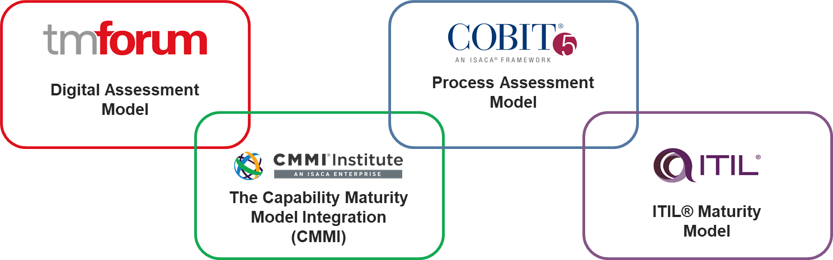
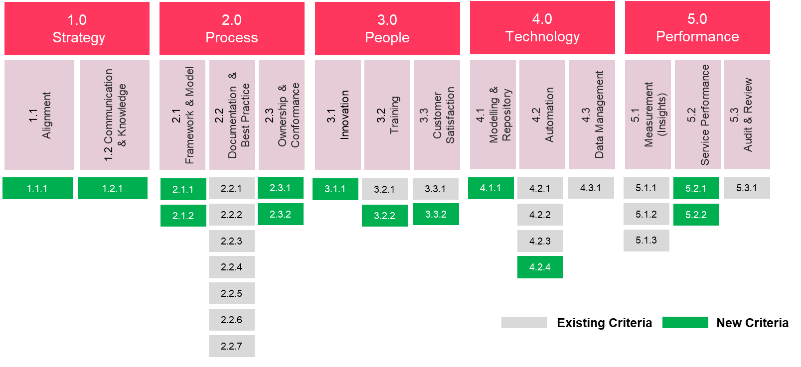
New Operational Excellence Maturity Model
Reference Frameworks and Industry Best Practices

Slide 16
Strategy Alignment Maturity Evaluation
No. | Sub-Dimension | Description | Questions | Criteria Weight | Evaluation Criteria/ Guidelines | Formula | Formula Calculation Hint | Required Evidence
1.1.1 | Strategy Alignment | This Sub-dimension measures the level of alignment of GDs projects with the TechOps Strategic objectives | Are all projects (of relevance to OX) aligned with the TechOps strategic objectives? This criteria focuses on projects of relevance to processes, in specific, projects impacting processes (process modeling, process change, process automation) | 50% | % of relevant projects aligned with TechOps Strategic Objectives | No. of projects (of relevance to OX) aligned with the TechOps strategic objectives/ Total No. of projects (of relevance to OX) | Focus of this criterion are projects impacting the process domain (process modeling, process change, process automation), and linked to TechOps strategic objectives | List of projects name (of relevance to OX) project card, or business case document that clearly link the project objectives to the TechOps strategic objectives
1.2.1 | Strategy Communication & Knowledge | This Sub-dimension measures how aligned are GDs stakeholders with strategic objectives through proper communication via cascading of TechOps objectives to GDs Departments | Are the TechOps Objectives cascaded to GDs departments? | 50% | % of GD departments to which TechOps objectives are cascaded. | No of GD Departments to which TechOps Objectives are cascaded / Number of GD Departments | No of department in the GD where the TechOps strategic objectives are cascaded divided on total no of department of GD | Status of objective cascade of each department within the GD Snapshot of the cascaded objectives to the department level

Slide 17
Process Maturity Evaluation
No. | Sub-Dimension | Description | Questions | Criteria Weight | Evaluation Criteria/ Guidelines | Formula | Formula Calculation Hint | Required Evidence
2.1.1 | Framework and Model | This dimension measures the alignment of the processes with the existing business process framework as well as the cross integration of the processes with other processes in other functions building an end to end process model. | Are the processes aligned with the existing business process framework? | 10% | % of processes aligned with the business process framework | No of processes aligned with the existing framework / Total no. of processes | Currently, the value of this criteria will be considered 0 as no TechOps Process Framework is present. | Map the process name with the process name in the process framework
2.1.2 |  |  | Are the processes cross integrated with other processes in other functions? (i.e. is there an end to end process value chain?) | 10% | % of cross functional processes integrated with other processes | No of integrated processes / Total no. of cross-functional processes | Determine cross functional processes, expert judgement for the received process document. Two values shall be used: yes or no | The process document shows the cross function interaction and communication with other relevant processes
2.2.1 | Documentation & Best Practice | This dimension measures the completeness of documentation of the processes against best practices as well as their validity in being up-to-date | Are the R&R of GD's functions fully covered by Processes |  | % of functions documented that are covered by processes | No. of function activities documented that covered by processes / Total No. of Functions | Map the GD processes to the functional description of the R&R to validate the % of R&Rs that are covered by processes | The approved GD R&Rs from HR, mapped to process name
2.2.2 |  |  | How many Processes are Approved or Published? (with a focus on the % of Approved processes as compared to total processes) | 10% | % of approved processes | Approved process / Total Processes | Determine the status for each process document (Approved/published, or draft ). | Process documents highlighting their status (Approved/published, draft)
2.2.3 |  |  | Are the documented process contents covering 7 parameters: scope, objectives, Responsibilities, I/P & O/P, Process Flow and description? Also, is the process document aligned with the process template? | 12% | % of process contents covered in the process template. | (2 Points for template alignment, 1 point for each of the Seven (7) process parameter)/9 (total No. of processes) | Each process parameter will count one point (maximum 7 points), alignment with process template shall take one of the following value: fully alignment (2 points), partially alignment (1 point) or not alignment | The process documents containing the listed parameters and aligned with STC template
2.2.4 |  |  | Are the processes in accordance with best practices, standards or eTom framework? | 10% | % of Process Mapped to standard best practice | No. of process mapped to BP or STD/ Total number of processes | Expert judgement for the received document. Two value shall be used: yes for the mapped process and no for processes not mapped to a standard | The process document list the references of the used BP/Std. otherwise the expert judgement shall be used.
2.2.5 |  |  | Are process reviewed regularly to continually improve for business needs (within 12 months)? | 8% | % of process revised or updated (within 12 months) | No. of process updated / Total number of approved processes | The approved/published process is updated during the last year? Two value shall be used: yes for the updated process and no the non-updated process | The process control part shows the process version and update.
2.2.6 |  |  | Are all process records (outputs) properly controlled? (Process work product) | 10% | % of controlled outputs records | Total number of controlled records / Total number of output records | The process outputs are saved and controlled in system or shared folders | List of the output name and the system that used to control and manage these outputs
2.2.7 |  |  | Is there any well define mechanism for Engaged Party (Vendor/Consulting)? | 10% | % of controlled 3rd party relevant processes | No. of controlled 3rd party relevant processes / total number of 3rd party relevant processes | Determine the processes that contain interaction with 3rd party and subject it to the criterion. | vendor management process, and sample of performance reports – if applicable
2.3.1 | Ownership & Conformance | This dimension measures process ownership level as well as process execution conformance to the established process model. | Are processes assigned process owner? | 10% | % of processes with assigned process owner | Processes with assigned owners/Total No. of processes | Is there a clear assignment for process ownership for each process? Two value shall be used: yes or no | Owner is listed in the process document
2.3.2 |  |  | Is the process execution conforming to the process model? (Conformance to process model) | 10% | % of processes whose execution conforms to the process model | No of conformed processes/ Total No. of processes (Sample of processes) | Currently, this criterion will not be measured as it requires preparations to check process execution logs against the process model. | Automated scripts output showing level of conformance of process execution to process model

Slide 18
People Maturity Evaluation
No. | Sub-Dimension | Description | Questions | Criteria Weight | Evaluation Criteria/ Guidelines | Formula | Formula Calculation Hint | Required Evidence
3.1.1 | Innovation | This sub-dimension measures the adoption of innovative design thinking practices | Are GDs practicing innovative methodologies and practices (design thinking) in process design? | 25% | % of processes (new and updated ) where design thinking was used in the design of such processes | No of processes in which design thinking was applied in their design (new/updated processes)/ total no of processes designed (new/updated processes) | for new or updated processes, determine if the design thinking approach is used during process design or improvements. | List of process name where design thinking have been used for design or improve the processes MoM or Report or any other evidence showing that design thinking was utilized for (new and updated) processes
3.2.1 | Training | This sub-dimension measures the level of training and awareness that is provided to the people to improve their skills and capabilities to manage the processes | How many people get Quality training / awareness last one year? | 20% | The training can be general quality training (ex. ISO9001, QMS, Lean Management) or domain quality related training (ex. ITIL, COBIT, PMP, ISO20000, ISO27001 ) | Number of Employees training / Total number of Employee | Get the number of employee who attend the training/awareness | Total No of STC Employee within the GD No of trained employees Attendance sheet, or certificate of attendance
3.2.2 |  |  | Are people getting process training and awareness for new / updated processes? | 20% | % of new / updated processes for which training was conduced | No of (new / updated) processes for which training, awareness has been conducted / Total number of (updated or new) processes | For each updated or new process, add a status for process training or awareness (training conduced / not conduced) | Processes name where training /awareness/handover sessions have been conducted Attendance sheet, or certificate of attendance for process training and handover session
3.3.1 | Customer Satisfaction | This sub-dimension measures if the culture of customer centricity is maintained. | Are there well defined mechanism to measure customer satisfaction level (internal & external)? | 20% | Response in percentile of customer entities | Number of customer feedback collected / Number of total customer entities | list all of the GD customers (internal or external) and identify the customers where the feedback/survey has been collected or not | Name of internal or external customers The customer (s) where the satisfaction or feedback collected or measured customer survey result or feedback
3.3.2 |  |  | Is the customer experience addressed during the process design? (Customers were engaged in process design workshops, and Customer feedback (Voice of customer) has been considered as an input for process design) | 15% | % of processes where customer experience has been addressed (7.5% for customer engagement in process design, 7.5% voice of customer mechanism) | No of processes designed with customer experience addressed (customer were engaged or Customer feedback has been considered)/ Total number of processes designed | Currently, this criterion will not be measured as it requires a specific mechanism to validate whether the customer has participated in process design or not and document such participation. | Design workshop MoM list the customer name, the customer is in the process approval board, also, process design itself as per process documentation captures "voice of customer".

Slide 19
Technology Maturity Evaluation
No. | Sub-Dimension | Description | Questions | Criteria Weight | Evaluation Criteria/ Guidelines | Formula | Formula Calculation Hint | Required Evidence
4.1.1 | Process Modeling Tool & Repository | This sub-dimension measures the adherence to the centralized BPM tool and repository | Are the processes modelled and centrally maintained using the centralized modeling tool (ARIS)? | 10% | % of processes documented and managed in ARIS | No of processes in repository/ total Number of processes | Currently, the value of this criteria will be considered 0 as no TechOps Processes are modeled and maintained using ARIS | Report from ARIS containing process name
4.2.1 | Automation | This sub-dimension measures the level of automation for processes and reporting. | Workflow Automation: Are the process functions fully/Partially automated through system workflows? | 20% | % of automated processes | Process Functions Automated / Total Number of process Functions | fully automated processes shall take 2 points and partially automated shall take 1 point (denominator shall be (No of processes X 2)) | List of the systems that used for the process automation mapped with process name
4.2.2 |  |  | Continuous Improvement: How many process Automation Enhancements in the last year? | 20% | Percentile of enhanced processes (for Non-automated /partial automated processes) | No. of Automation Enhancement / Total No of processes that are subject for enhancement (partially automated + not automated +latest enhanced processes) | for each process, determine if there is any automation enhancement during the last year | Name of the automated processes during the year, and the systems that are used for the automation
4.2.3 |  |  | KPIs & Reports Automation: Are the Key departmental KPIs outcomes and progress reports automated? | 25% | Percentile of KPI automation | No of automated KPI/Total number of KPIs | For each KPI, its automated status shall be determined | Status of automation for each KPIs the automated KPI report
4.2.4 |  |  | Are the existing automation systems supported by AI & machine learning capabilities? | 10% | % of systems (in scope) that have AI capabilities | 50% (No of system with AI/ML capabilities/ total number of system) 50% (No of utilized AI/ML capabilities/ No of system with AI/ML capabilities) | List all systems that used for process automation, and assign 1 point for AI/ML feature availability and 1 points if the feature is in use | Link AI/ML feature in the system manual/features sheet, sample of utilization result
4.3.1 | Data Management | This sub-dimension measures how processes data are maintained and stored | Data Archiving:- Is data archiving mechanism documented and how its executed on ground | 15% | % of archived process outputs | 'Number of archived output / Total number of output. | identify the archiving status of each outcome or output | List of outputs archiving status

Slide 20
Performance Maturity Evaluation
No. | Sub-Dimension | Description | Questions | Criteria Weight | Evaluation Criteria/ Guidelines | Formula | Formula Calculation Hint | Required Evidence
5.1.1 | Process Insight & analytics | This sub-dimension measures if process performance is maintained | Are processes including defined KPI's in order to monitor and control process-related performance? | 20% | % of processes with KPIs | No. of process with KPI/ Total No. of Processes | check the process document if it is containing the KPI or not? The value will be Yes or No | The process document contains the KPIs
5.1.2 |  |  | Are process KPI's being measured and reported to relevant management within the GD and other stakeholders? | 20% | % of measured process KPIs | No. of measured process KPI/ Total No. of process KPIs | for each KPI, determine the measurement status | Report for the process performance
5.1.3 |  |  | Are measured and reported process KPI's meeting their targeted value and being improved? | 20% | % of Improved process KPI during one year | No. of Improved KPI/ Total No. of process KPIs | for each KPI, determine the improvement status | The KPI targets have been improved through different process analysis and evidence reports
5.2.1 | Service Performance | This sub-dimension measure if service management practices are in place, in specific, Service Catalogue presence as well as SLAs. | Is there a service catalogue (SC)? Are GDs services captured in the catalogue? | 10% | % of departments with a service catalog | No of departments that have a SC/ Total No of departments | check if there is a service catalogue for the department or not? (for complete sc:2 points, for partially completed or service list: 1 point) | The service catalogue shall be provided, or list of services
5.2.2 |  |  | Are the services, requests and issues managed through a defined SLA? | 10% | % of services managed using SLA | No of Service managed by SLA/ Total number of services | One point for every service with an assigned SLA | Service level definition for each service
5.3.1 | Audit & Review | This sub-dimension measure that the processes and procedures are periodically audited to ensure conformance with the defined practices | If there is any internal audit conducted on the GD, How many raised observations / findings have been closed on time within one year period | 20% | % of closed observations/ findings raised in the internal audit report on time | No. of closed observations on time /Total No. of observations findings | collect the audit reports, its actions linked to the processes and the status of each action | Audit report and the status of the closed observation

Slide 21
Thank you

